Slide 1
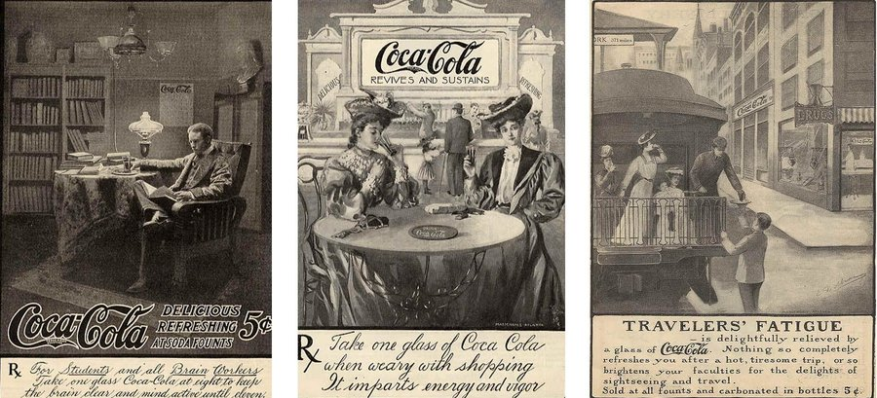

Slide 2
“For students and all brain workers -
Take one glass Coca-Cola at night to keep the brain clear and active until eleven.”
What claim is being made here?

Slide 3
Drinking Coca-Cola makes you more…
    … alert
    … smart
    … able to concentrate
    … sharp
How could we test this?

Slide 4
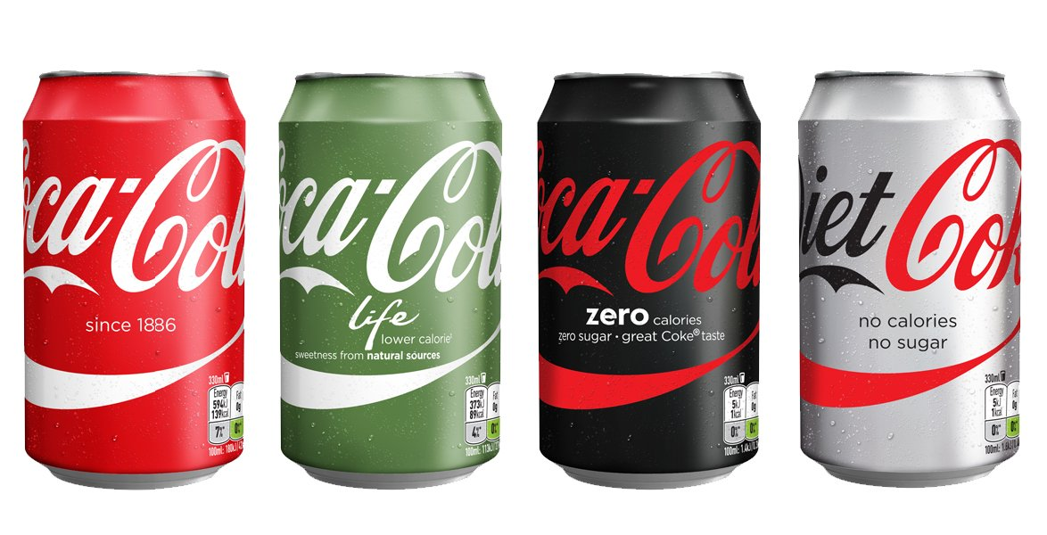
What is it in the Coca-Cola that makes your “brain clear and mind active until eleven”?

Slide 5
Designing our Trial
Who should we include?
What should we include?
How do we measure how clear the brain is or how active the mind is?

Slide 6
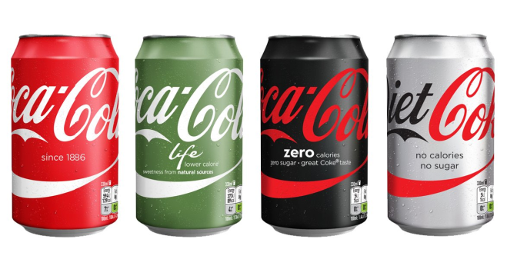
Our Trial
You do not have to participate in our trial!
If you do participate you will be given a drink of coke – you will be allocated to one of four categories.
If you know you are allergic, or really don’t like coke, please let me know – you can still participate.
Please don’t discuss which drink you think you have been given!

Slide 7
Baseline test
Find as many words as you can in the word search.
Circle/highlight the word & tick it off from the list.
5 minutes

Slide 8
Types of RCT
Which is best?
Which should we try to do?
Unblinded
  When the participant and the researcher knows what is in the ‘treatment’
Blind
  When the participant doesn’t know whether they are receiving the treatment or a control, but the researcher carrying out the test does
Double blind
  When neither the participant or the researcher carrying out the treatment knows whether they are receiving the treatment or a control

Slide 9
Allocating ‘Treatments’
How can we do this fairly?
A
B
C
D

Slide 10
‘Treatment’
Drink your whole cup of coke please.

Slide 11
Allocating ‘Treatments’
What might affect how participants perform in this trial?
Why is knowing about this important?

Slide 12
Treatment Group Comparison
 | A | B | C | D
I drink cola every day
I drink cola more than four days a week
I drink cola more than once a week
I never drink cola

Slide 13
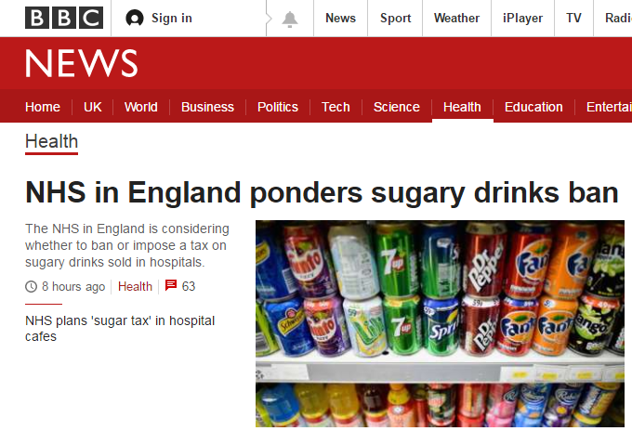
Why do trials matter?
“During recent trials, one hospital that banned sugary drinks found the overall total number of drinks sold did not decrease, meaning vendors were financially unaffected.”
9th November 2016
“Chief executive Simon Stevens says he wants the NHS to set a healthy example and "practise what we preach".”
“He says trials at four NHS hospitals show either option could work.”

Slide 14
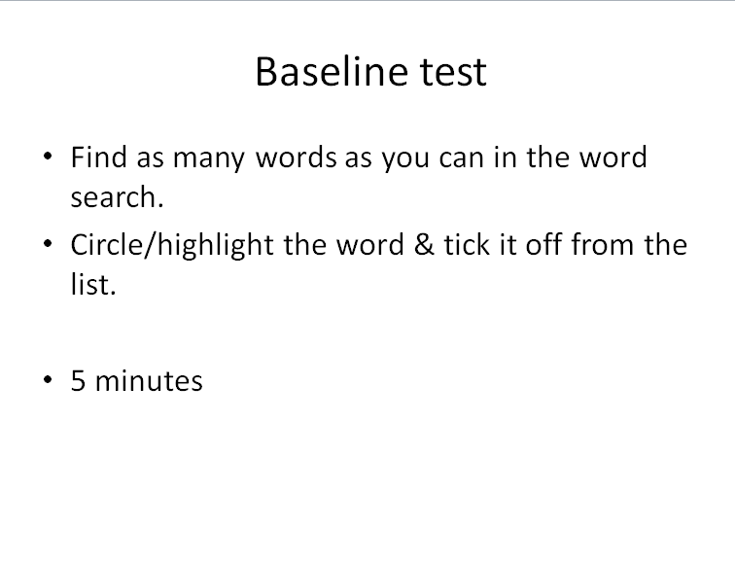
Re-test
Complete your final word search using the same method as before

Slide 15
Results analysis
Group | Average number of words before the treatment | Average number of words after the treatment | Difference (number) | Difference (percentage)
A
B
C
D
X

Slide 16
Results analysis
Was this really a Blinded trial?
Group A →
Group B →
Group C →
Group D →
What could have affected the outcome?

